Slide 1

Bitcoin Price Prediction
BATCH:C9
Y20ACS580 U.Tarun
Y20ACS532 P.Mounika
Y20ACS574 T.Eswar Prasad
Y20ACS542 R.L.Pujitha
Guide
Mrs.M.KARUNA

Slide 2
Table of contents
Abstract
Existing system
Proposed system
Design methodology
Implementation
Result
Conclusion

Slide 3
Abstract
In today's digital marketing landscape , Bitcoin reigns as the premier cryptocurrency , facilitating anonymous transactions over the internet. However , its virtual nature and extreme volatility pose significant challenges for accurate forecasting .This study aims to develop a precise predictive model for Bitcoin values, utilizing various machine learning techniques. Incorporating technical indicators like Exponential Moving Average (EMA), Relative Strength Index (RSI), and Moving Average Convergence Divergence (MACD), we analyze data sourced from Yahoo Finance to understand the factors influencing Bitcoin's value.

Slide 4
Existing System
The existing system mainly focuses on classifying data to generate buy/sell signals , aiding investors in decision-making .
Bitcoin price prediction encompass various approaches , with a focus on technical analysis and machine learning.
Technical analysis utilizes historical price data and indicators like RSI and MACD to identify potential trends.
However, these methods all face challenges due to the inherent volatility of the cryptocurrency market and the limitations of model accuracy.

Slide 5
Proposed system
Utilizing a combination of classification and regression techniques to enhance overall performance.
For Classification tasks, we use the XGBoost algorithm renowned for its accuracy and efficiency in handling structured data which is used to generate buy/sell signal that helps the investors.
For Regression tasks, we use the Random Forest algorithm, known for its robustness and ability to handle noisy or missing data effectively which is used to predict future price of bitcoin.
These dual approaches ensures that we address a wide range of predictive modeling scenarios with optimal efficiency and accuracy.

Slide 6
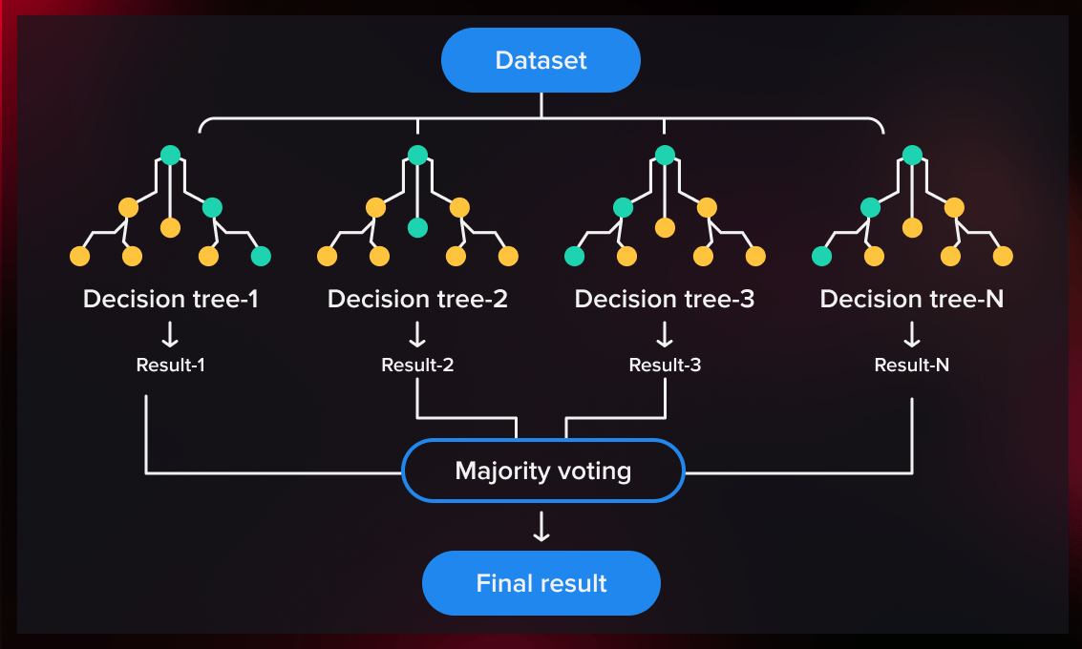
Design
RANDOM FOREST ALGORITHM
The random forest algorithm is a machine learning algorithm that combines the results of multiple decision trees to reach a single result.
It is a supervised learning algorithm that can be used for classification and regression problems.
Random Forest is a classifier that contains a number of decision trees on various subsets of the given dataset and takes the average to improve the predictive accuracy of that dataset.

Slide 7
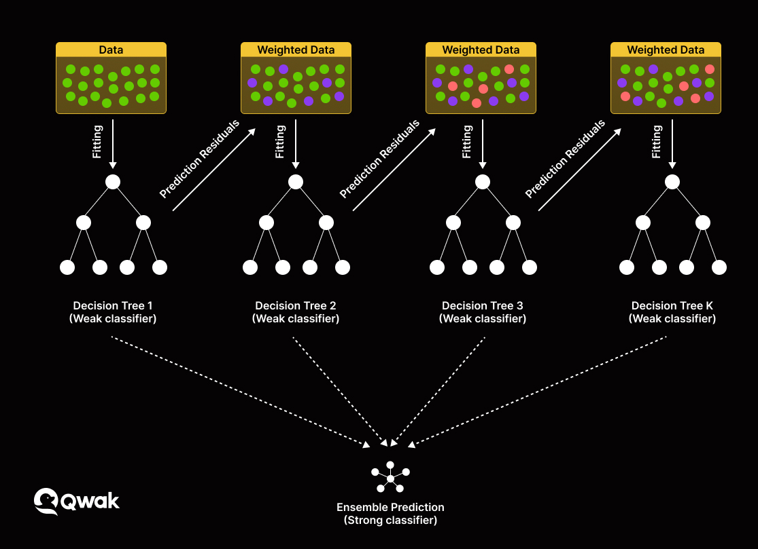
XGBOOST ALGORITHM
XGBoost , short for eXtreme Gradient Boosting, is a powerful machine learning algorithm known for its efficiency, speed, and accuracy.
It belongs to the family of boosting algorithms, which are ensemble learning techniques that combine the predictions of multiple weak learners.

Slide 8
TECHNICAL INDICATORS
Technical Indicators are statistical calculations based on historical price , volume , or sentiment data of a financial asset . Such as stocks , currencies or cryptocurrencies.
Those Indicators are :
EMA (Exponential Moving Average)
MACD (Moving Average Convergence Divergence)
RSI (Relative Strength Index)
MOM (Momentum)
PROC (Price Rate Of Change)

Slide 9
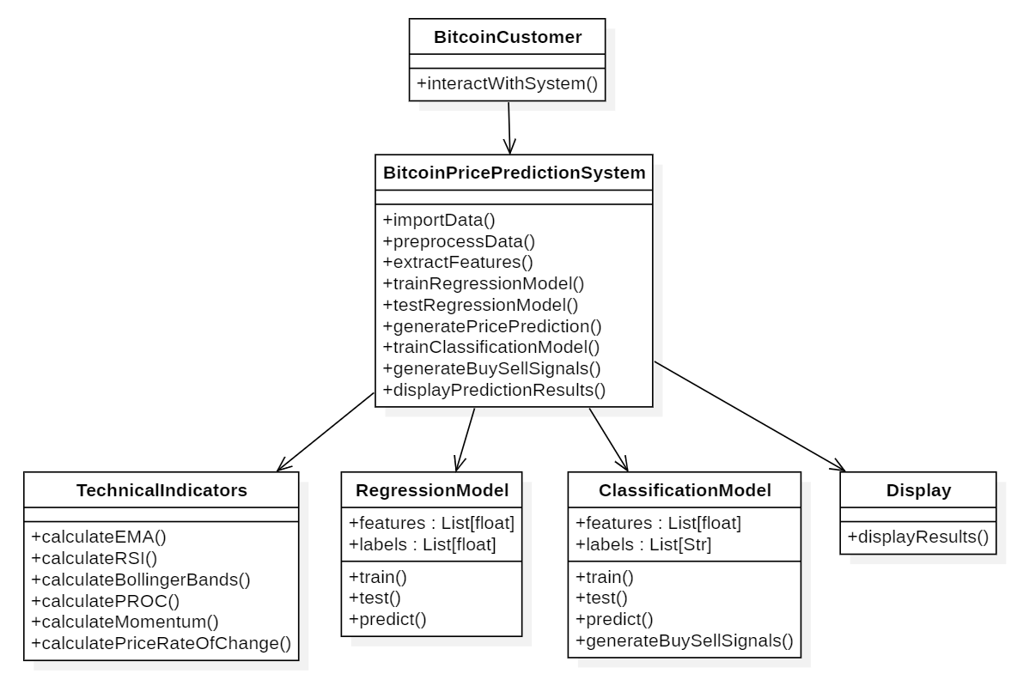
Class Diagram

Slide 10
IMPLEMENTATION
Dataset
Preprocessing the data
Feature Engineering
Splitting the data
Model Selection
Training & Testing
Model Evaluation
https://github.com/Tarunutla15/Bitcoin_Price_Prediction.git

Slide 11
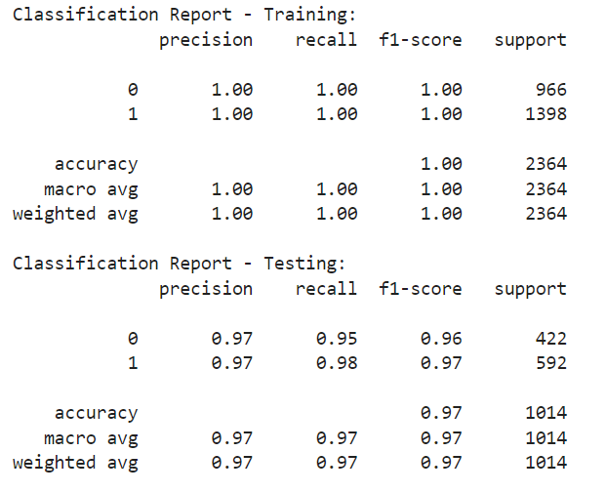
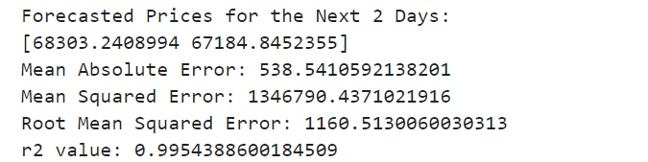
RESULT
Fig. Classification Report

Slide 12
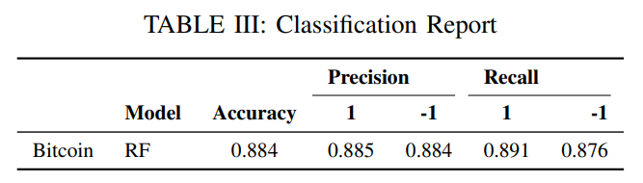
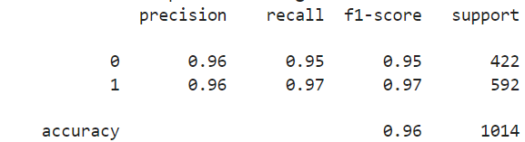
Comparison
Existing system Model accuracy
Proposed system model accuracy

Slide 13
conclusion
In this project, we developed a comprehensive approach to predict Bitcoin prices using machine learning techniques and technical indicators . We began by preprocessing the data . Feature engineering played a crucial role in enhancing the predictive power of our model . We calculated various technical indicators. Those indicators provided valuable insights into market trends and momentum , which were utilized by our predictive model . For model training , we utilized various algorithms .
While our approach demonstrate promising results , it's essential to acknowledge certain limitations and areas for improvement . Moreover, further optimization and fine-tuning of model hyperparameters may enhance the model's predictive accuracy and robustness.

Slide 14
THANK you

